Slide 1
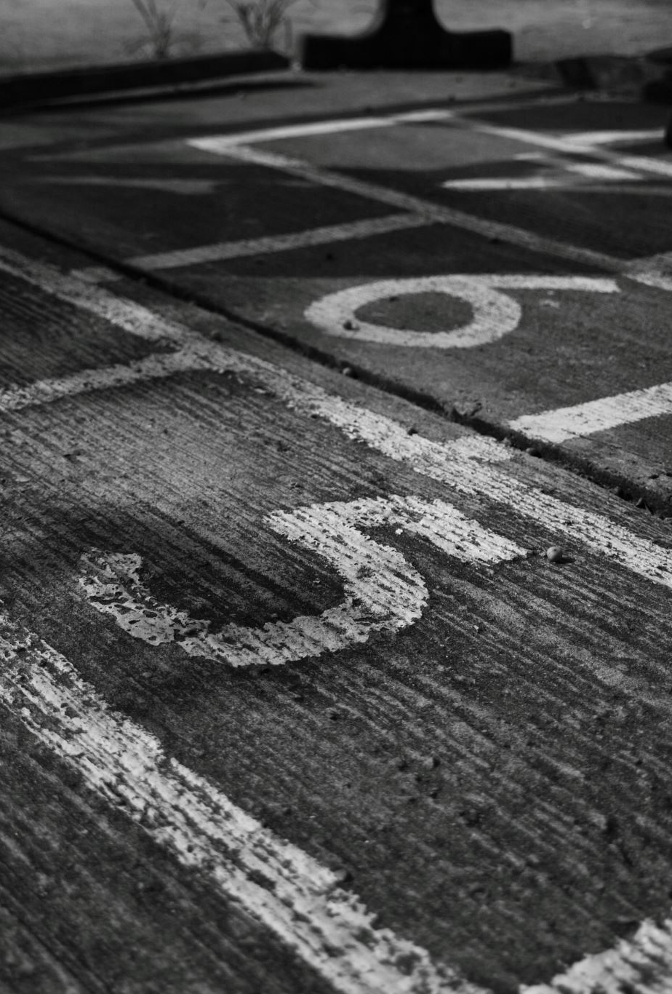
PROJECT (CS-891-13533-FALL 2022
Multi-classifier-based Deepfake detector using deep & Handcrafted Features
Prudhvi Reddy Mali ID: Y943Z365
Advisor: Ajita Rattani

Slide 2
Introduction to DeepFake
In the recent period there has been massive progress in synthetic image generation and manipulation which significantly raises concerns for its ill applications towards society.
This would result in spreading false information, leading to loss of trust in digital content.

Slide 3
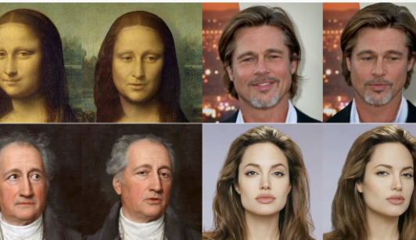
Deepfakes
Deepfakes (a portmanteau of "deep learning" and "fake") are synthetic media in which a person in an existing image or video is replaced with someone else's likeness

Slide 4
Exiting methods on Deepfake CNN-Based Methods
CNN-based XceptionNet and ResNet50
EyeBlinking Detection
LipForensics

Slide 5
PROJECT : Multi-classifier based DeepFake Detection
In this project we use the Celeb-DF dataset.
In this dataset contain original videos and fake or duplicate.

Slide 6
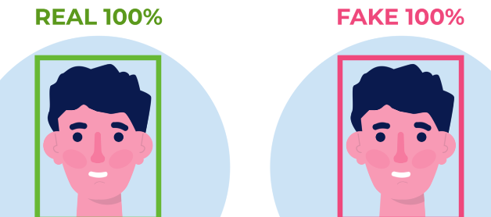
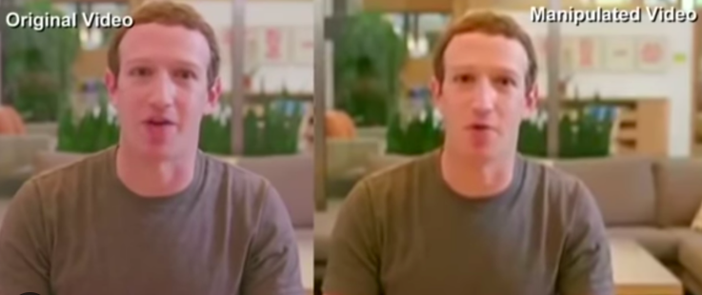
DeepFake Dataset
In this project we use the Celeb-DF dataset.
Deepfake dataset contains original videos and fake or duplicates.
In this dataset contain the real videos of 590.
Fake videos of 5639.

Slide 7
ResNet
ResNet stands for Residual Network and convolutional neural network (CNN) based model.
It consists of a series of convolutional blocks.
The main advantage is to avoid the vanishing gradient problem. By having a skip connection.

Slide 8
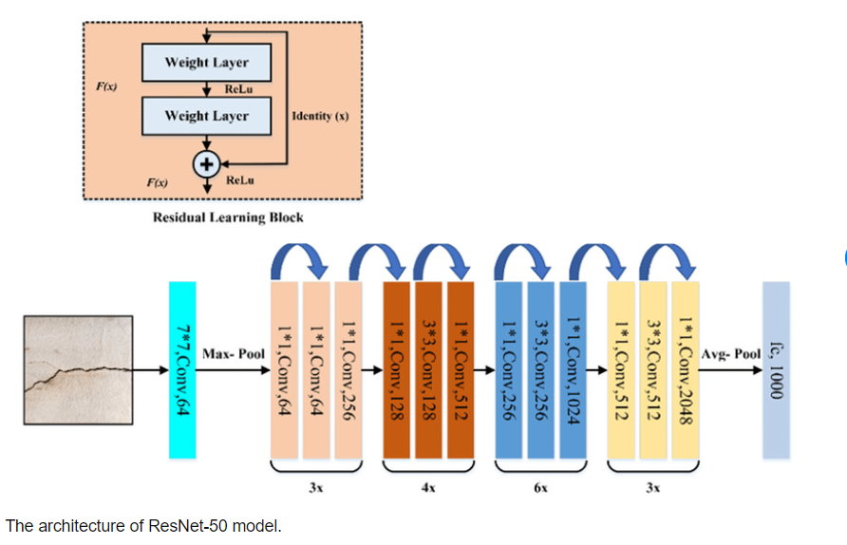
ResNet-50 model architecture

Slide 9
ResNet
We have transfer learning to retrain the final 10 layers in the ResNet model.
Using the celeb_deepfake version2 dataset.
Transfer Learning: Having the preordained model which is ResNet trained on Image net data.
We have freeze the initial 130 layers and made the rest of the layer trainable on the deepfake dataset.
Test accuracy of 92.424%.

Slide 10
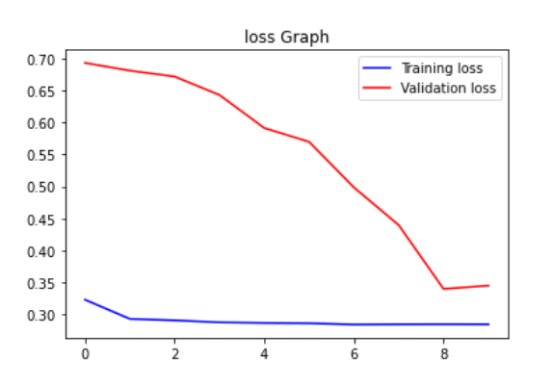
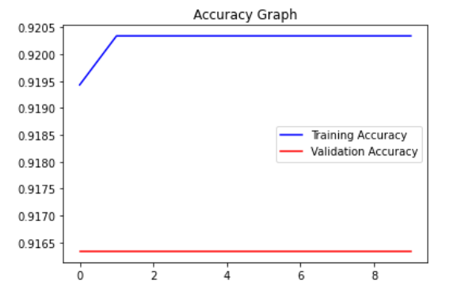
ResNet Accuracy Graphs

Slide 11
XceptionNet
Xception is an extension of the Inception architecture which replaces the standard Inception modules with depthwise separable convolutions.
cnn’s based model

Slide 12
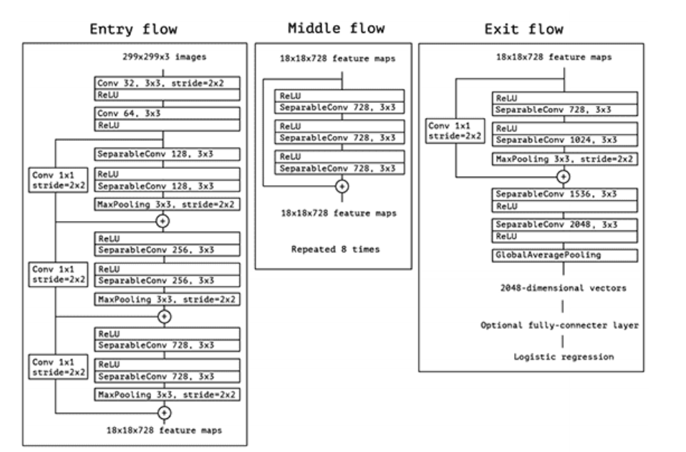
XceptionNet Architecture

Slide 13
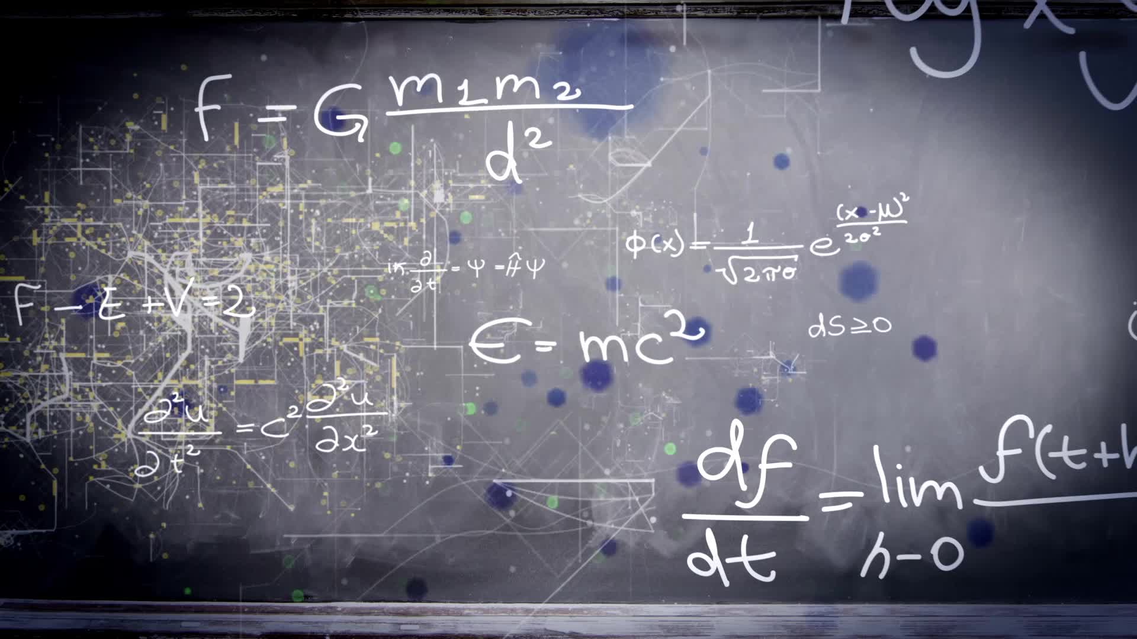
XceptionNet
We have transfer learning to retrain the final layers in the Xception model.
Using the celeb version2 dataset.
Transfer Learning: Having the pre-trained model.
It saves time
Number of parameters.
Test accuracy 92.160%.

Slide 14
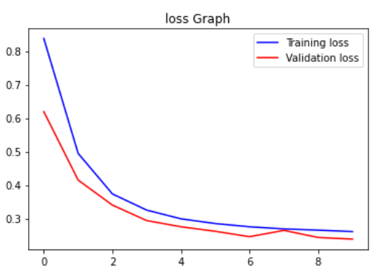
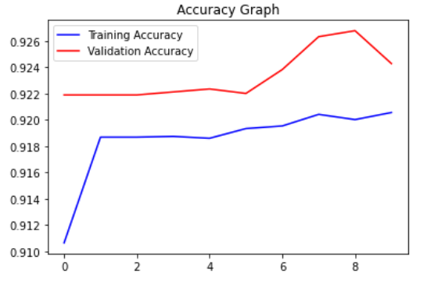
XceptionNet Accuracy Graphs

Slide 15
Multiclassifier(ResNet + XceptionNet)
As we trained two models Xception and ResNet.
We concatenate both models on a final Dense layer.
So that we will able to get the best of both models.
Once we have concatenated models ready we have trained the celeb-df dataset.
The test accuracy is 93.00%

Slide 16
ResNet + Xception
Flow Diagram:
FV
ResNet
real
Concatenated
FV
Dense
FV
FV
fake
Xception

Slide 17
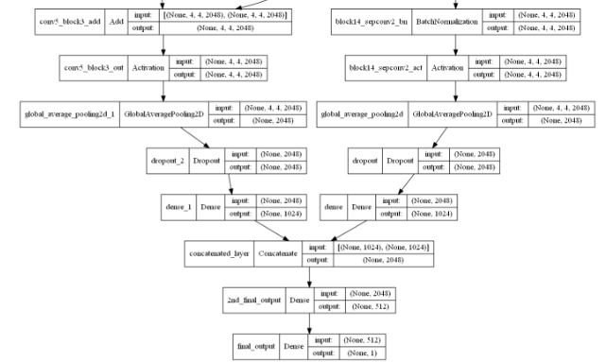
ResNet + Xception Net

Slide 18
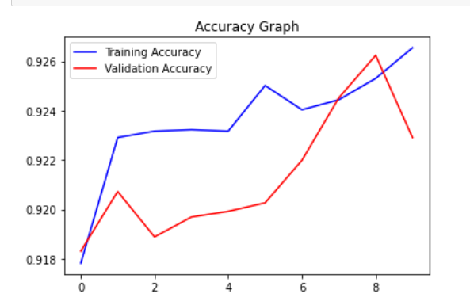
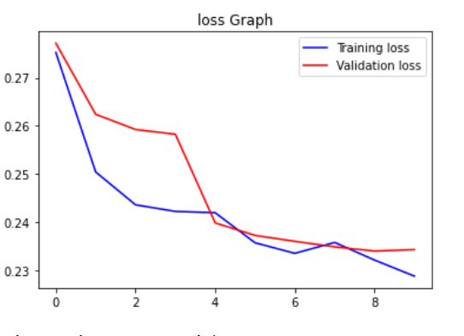
ResNet + Xception Net Accuracy Graphs

Slide 19

HOG
It stands for the histogram of oriented gradients.
It looks at the gradient magnitude and gradient direction of the image.
Binding then creates a vector.

Slide 20
Histogram of Oriented Gradients
Every Image in the deepfake dataset has dimensions (128,128,3).
Which is a 2D image by using HOG we will be able to convert the ND image to a 1d vector.
That 1D vector consists of crucial information about the image.
Which can improve model performance.
After this we concatenate the concatenated model and HOG model at the Dense layer to get better accuracy.

Slide 21
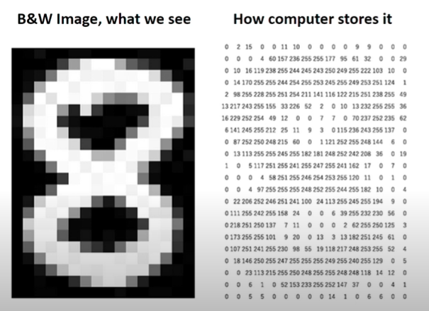
Histogram of Oriented Gradients
No of pixel(22*16):352
Pixel value for black:~0
Pixel value fir white:~255
Feature of the image data
Feature | Label
F1,F2,…F352 | 8

Slide 22
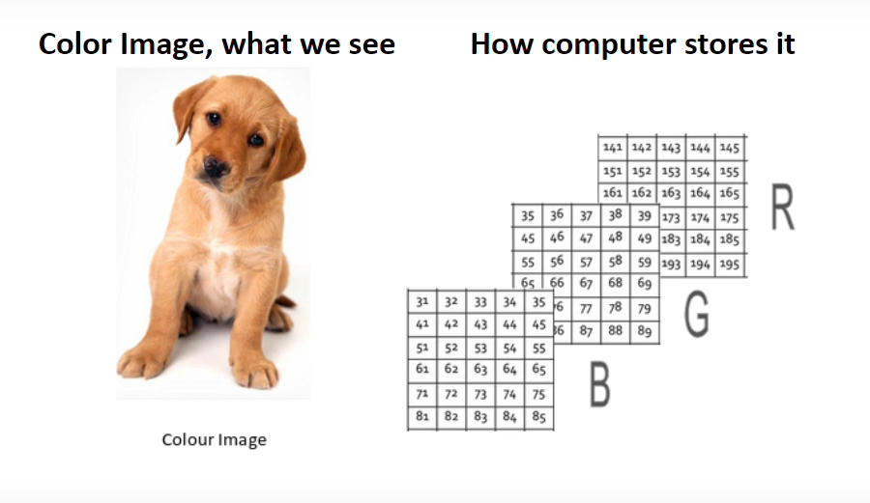
Feature Extraction from image Data
No of pixel (22*16*3):1056
3-pixel matrices: One each
For Red/Green/Blue
Pixel value for B/G/R:0-255
Features of this image data
Feature | Label
F1,F2,….F352 | Dog

Slide 23
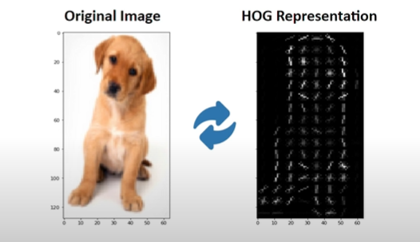
HOG INTRO
Plot image pixel orientation and gradients on a histogram.
Histogram of Oriented Gradients.
Simplifies representation of images containing only the crucial information.

Slide 24
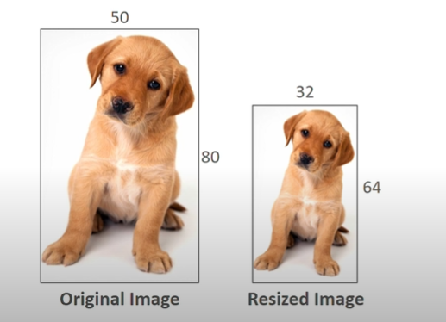
Image Preprocessing
Resized image size: 32*64
HOG Cell size: 4*4
Recommended:
Image size: 64*128
Cell size:8*8/16*16

Slide 25
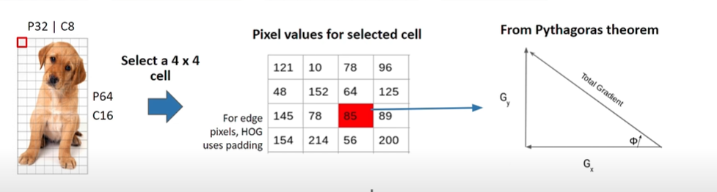
Calculate Gradient & Orientation

Slide 26
Calculation Gradient Orientation
Gradient in x dir.(Gx)
89-78=11
Gradient in y dir.(Gy)
64-56=8
Total Gradient Magnitude
Sqrt[(Gx)*2+(Gy)*2]
Sqrt[(11)*2+(8)*2]
13.6
Orientation(theta)
atan(Gy/Gx)
36 deg

Slide 27
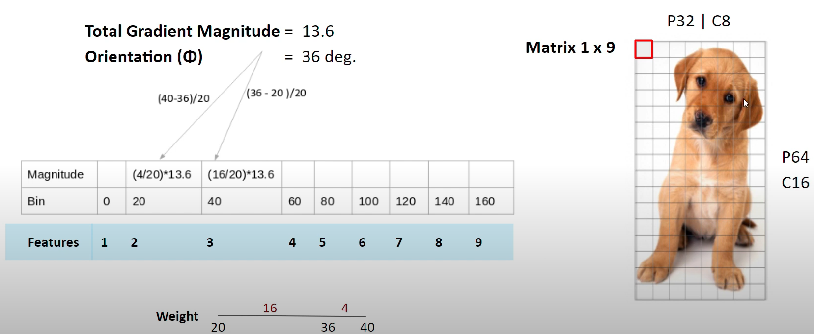
Build Histogram

Slide 28
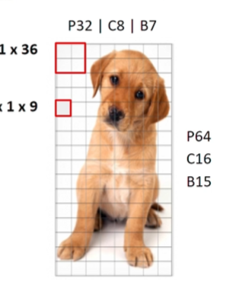
Normalization
Gradients for highlighted Block(36 features)
V=[a1,a2,….a36]
Root of the sum of squares:
K=sqrt[(a1)*2+(a2)*2+...(a36)*2]
Normalized Vector=[a1/k..a36/k]
NV creates all 105 blocks, having 36 features.
Image Features 1*3780 matrix.

Slide 29
Deep Features + HOG
Flow Diagram
FV
Concatenated
real
ResNet
ResNet + Xception +
HOG
Dense
Xception
FV
fake
HOG
FV

Slide 30
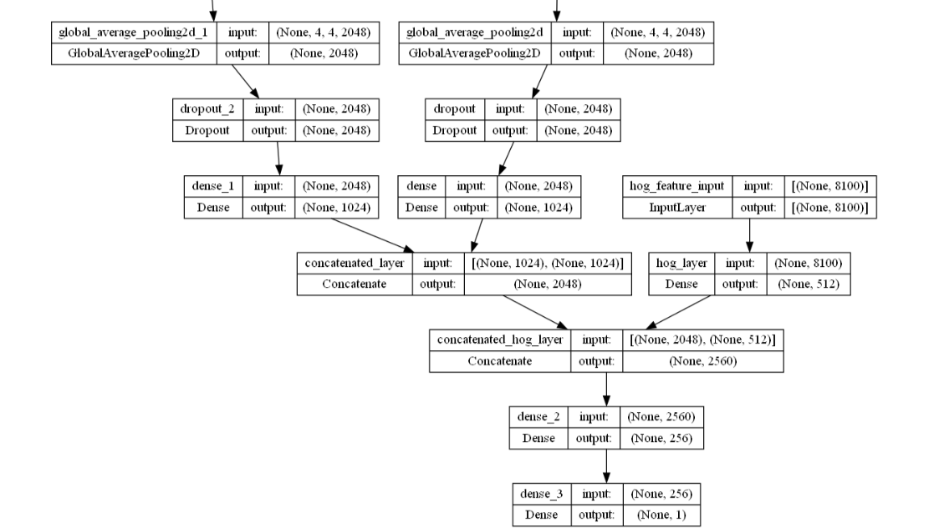
Deep Features + HOG

Slide 31
Final Results
MODELS | TEST ACCURACY
ResNet | 92.160%
Xception | 92.424%
ResNet + Xception | 93.00%
ResNet + Xception + H0G | 99.21%

Slide 32
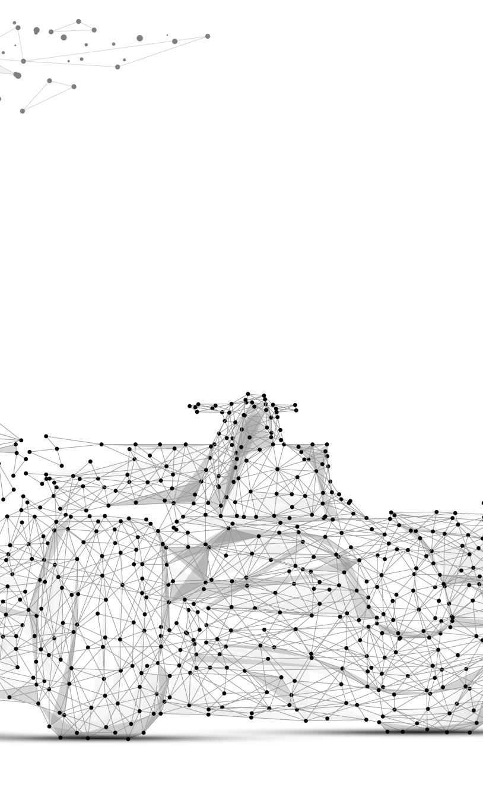
Conclusion
In this project, we used Multi-classifier based DeepFake Detection
Multiple classifiers were formed by concatenating the dense layers from XceptionNet and ResNet
Further, fusion of hand-crafted HOG and Deep features was performed by feature level concatenation. It obtained the best performance.

Slide 33

THANK YOU, PROFESSOR, FOR YOUR SUPPORT.

